Slide 1
Ch. 7.7-10 Sorting

Slide 2
Q1:
What is time complexity of LSD (Least Significant Digit) radix sort?

Slide 3
Ans:
O(d*(n+r))
r: number of buckets
n: Amount of data
d: digits base on the base.
i.e. b = 10. k is the maximum possible value, then d would be O(log₁₀(k)).
Subroutine: Counting sort or Bucket sort
d rounds base on digits.

Slide 4
Q2:
What is space complexity of LSD radix sort?

Slide 5
Ans:
O(n + r)
r: number of buckets
n: link pointers

Slide 6
Q3:
Is Radix Sort a stable sort? Why?

Slide 7
Ans:
Radix Sort is stable.
The radix sort algorithm sorts number by 1 digit at a time. For each d round, the number appearing before would never move to the number appearing later. This ensures that the number appearing before other numbers in the input array would maintain that same order in the final.

Slide 8
Q4:
Give an application example for the linear-time sorting algorithm.

Slide 9
Ans:
Radix sort application:
English dictionary base on alphabet radix
Library books index.

Slide 10
Q5:
(1) Define what does “Sorting on several keys” mean.
(2) For the sorting algorithm on multiple keys, please propose an application example other than the sorting deck of cards in the textbook.

Slide 11
Ans:
(1) Sorting on several keys: A list of records is said to be sorted with respect to the keys 𝐾1, 𝐾2, ... , 𝐾𝑟 iff for every pair of records 𝑖 and 𝑗, 𝑖 < 𝑗 and (𝐾1,𝐾2,...,𝐾𝑟) ≤ (𝐾1,𝐾2,...,𝐾𝑟)
(𝑥₁,...,𝑥_{𝑟}) ≤(𝑦₁,...,𝑦_{𝑟}) iff either 𝑥_{𝑘} =𝑦_{𝑘}, 1≤𝑘≤𝑛,and 𝑥_{𝑛+1} < 𝑦_{𝑛+1} for some 𝑛 < 𝑟, or 𝑥_{𝑘} =𝑦_{𝑘},1≤𝑘≤𝑟
(2) English dictionary, numbers have a specific range.

Slide 12
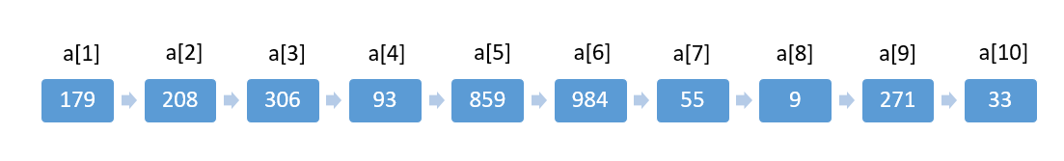
Q6:
(1)We provide the LSD Radix Sort code(in next page, in textbook) below. Please explain what does the code of RadixSort do. You may use the following initial values of the a[] array elements to explain the algorithm.
(2) Write the status of the list (12, 2, 16, 30, 8, 28, 4, 10, 20, 6, 18) at the end of each pass of RadixSort. Use r=10.

Slide 13
template<class T>
int RadixSort(T *a, int *link, const int d, const int r, const int n){
// Sort a[1:n] using a d-digit radix r sort. digit(a[i],j,r) returns the jth radix-r
// digit(from the left) of a[i]'s key. Each digit is in the range is [0,r).
// Sorting within a digit is done using a bin sort
int e[r],f[r];
int first=1;
for(int i=0;i<n;i++) link[i]=i+1;
link[n]=0;
for(i=d-1;i>=0;i--){
// Sort on digit i
fill(f,f+r,0); // initialize bins to empty queues
for(int current=first;current;current=link[current]){
//put records into queue/bin
int k=digit(a[current],i,r);
if(f[k]==0) f[k]=current;
else link[e[k]]=current;
e[k]=current;
}
for(j=0;!f[j];j++); // Find first nonempty queue/bin
first=f[j];
int last=e[j];
for(int k=j+1;k<r;k++){
if(f[k]){
link[last]=f[k];
last=e[k];
}
}
link[last]=0;
}
return first;
}

Slide 14
Ans (1)
That link is an array that indicate the next address of next value. The “first” is the first index from the unsorted array.
Pass 1: 271 93 33 984 55 306 208 179 859 9
Pass 2: 306 208 9 33 55 859 271 179 984 93
Pass 3: 9 33 55 93 179 208 271 306 859 948

Slide 15
Ans: (2)
12, 2, 16, 30, 8, 28, 4, 10, 20, 6, 18
Step 1: 30, 10, 20, 12, 2, 4, 16, 6, 8, 28, 18
Step 2: 2, 4, 6, 8, 10, 12, 16, 18, 20, 28, 30

Slide 16
Q7:
Please propose a hybrid sorting algorithm and discuss how and why the algorithm works, particular explain when and why one algorithm is switched to another one in the hybrid approach. You may go online and search for Hybrid Quicksort Algorithm (Quicksort+Insertion sort) to learn how people discuss the working principle of the algorithm.

Slide 17
Ans:
Quicksort: one of fastest sorting algorithm for large inputs in average case because of tail recursive.
When dividing elements less than threshold, switch the sorting methods to insertion sort because it has good performance at small inputs.

Slide 18
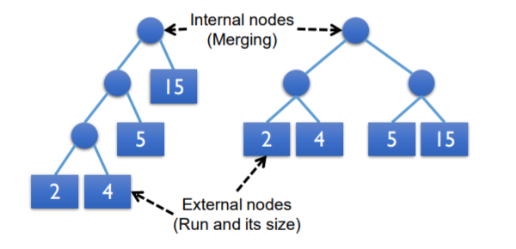
Q8:
(1) What does “Optimize merge” mean?
(2) Why should we distinguish nodes into external nodes and internal nodes?

Slide 19
Ans: (1)
Optimize merge: make the cost of merge tree minimized.
Tree A 𝐶𝑜𝑠𝑡 = (2 + 4) + (2 + 4 + 5) + (2 +4+5+15) =2∗3+4∗3+5∗2 +15∗1 = 43
Tree B 𝐶𝑜𝑠𝑡
=2∗2+4∗2+5∗2 + 15 ∗ 2 = 52

Slide 20
Ans (2)
external nodes: the runs before merge.
Internal nodes: merge several runs result.

Slide 21
Q9:
Please complete the following table and give examples to the worst and best time complexity cases. Explain why some have the same If best, average and worst time complexities.
Algorithm | Time Complexity
 | Best | Average | Worst
Insertion Sort
Quick Sort
Heap Sort

Slide 22
Ans:
Algorithm | Time Complexity
 | Best | Average | Worst
Insertion Sort | O(n) | O(n²) | O(n²)
Quick Sort | O(n*log(n)) | O(n*log(n)) | O(n²)
Heap Sort | O(n*log(n)) | O(n*log(n)) | O(n*log(n))

Slide 23
Q10:
Please give an example of the external sorting.
(1) Introduce the concept and practical application of the algorithm.
(2) Give a brief introduction to the implementation of the algorithm

Slide 24
Ans:
(1) External sorting is sorting algorithms that can handle massive amounts of data. External sorting is worked when the data don’t fit into the main memory
(2) External merge sort algorithm, which sorts chunks that each fit in RAM, then merges the sorted chunks together.

